Slide 1
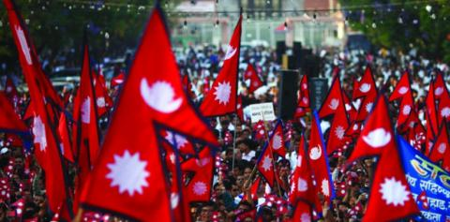
Human Rights in Nepal under Democracy Rule
Presented By:-
Pamas Kulung Rai
Ronak Podel
Shekh Atiulah
Sujan Thing

Slide 2
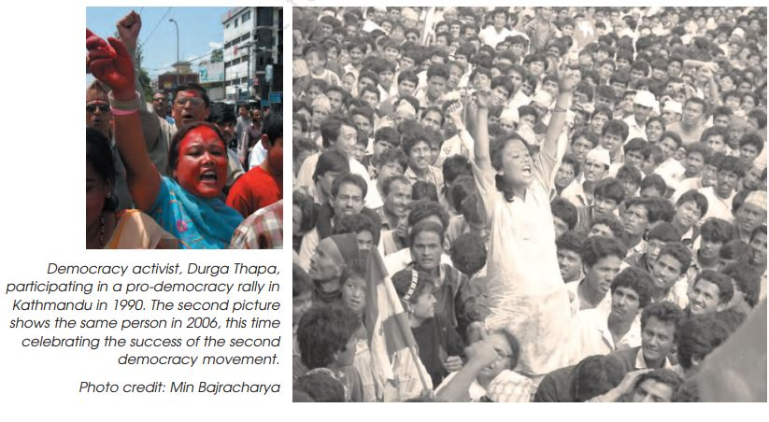
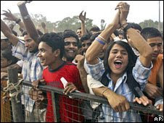
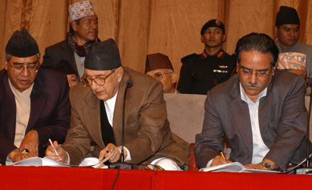
Introduction
On [Insert Presentation Date], we delve into Nepal's democratic journey, marked by significant shifts from absolute monarchy to constitutional monarchy in 1990 and ultimately to a federal democratic republic in 2008. Today, our focus turns to the cornerstone of this transition – human rights. Within Nepal's democratic context, we explore the challenges, progress, and imperatives surrounding the protection and promotion of these fundamental rights. From historical contexts to constitutional frameworks, civil and political rights to socio-economic considerations, we'll unravel the multifaceted landscape of human rights in Nepal. Join me as we navigate through the complexities that define Nepal's pursuit of democracy and social justice.
federal democratic republic in 2008
Peace Agreement of 2006

Slide 3
Thesis Statement
Our exploration into Nepal's democratic transition and its impact on human rights is encapsulated in the thesis statement: "Exploring the Challenges and Progress of Human Rights in Nepal's Democratic Transition: Assessing the Role, Impact, and Imperatives of Human Rights Protection in Upholding Democratic Values and Social Justice." This thesis serves as our guiding beacon, delving into the specific challenges post-transition, the progress made, and the ongoing imperative to fortify a robust human rights framework within Nepal's democratic system. As we navigate through this analysis, we aim to unravel the intricacies, identify key milestones, and outline the essential steps needed to ensure the protection and promotion of human rights in this evolving democratic landscape.

Slide 4

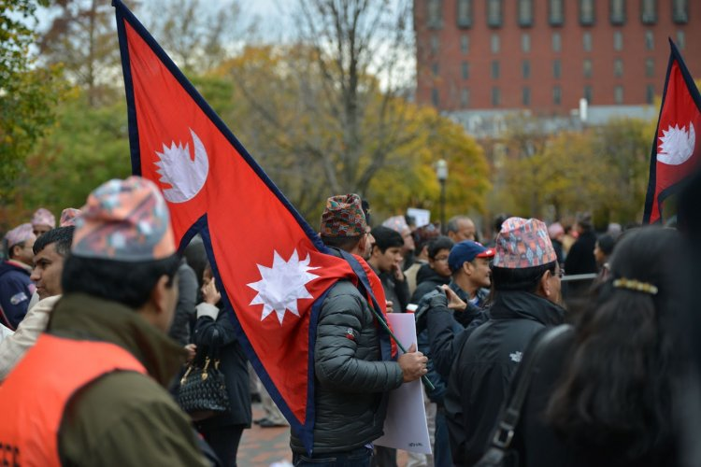
Historical Context
In the pre-democracy era, Nepal was entrenched in autocratic rule under an absolute monarchy, suppressing dissent and curtailing fundamental freedoms. The late 1980s and early 1990s witnessed a burgeoning people's movement, fueled by dissatisfaction with authoritarian governance. This movement demanded political reforms, leading to the establishment of a constitutional monarchy in 1990. Despite initial democratic strides, the monarchy retained substantial power, fueling continued discontent and unrest. The ensuing Maoist insurgency from 1996 to 2006 further destabilized the nation, prompting comprehensive changes in governance structures and ultimately culminating in the abolition of the monarchy. The Comprehensive Peace Agreement of 2006 formalized the end of the conflict, setting the stage for Nepal's transition into a federal democratic republic in 2008. This historical evolution forms the backdrop against which we analyze the complexities of Nepal's human rights journey.

Slide 5
Constitutional Framework
In 2015, Nepal adopted a constitution that serves as the bedrock of its commitment to human rights. This constitutional framework ensures a range of fundamental rights, including the right to equality, freedom of speech, and social justice. It prohibits discrimination based on religion, race, sex, caste, origin, language, or ideology, emphasizing equality before the law and non-discrimination in public services. The constitution guarantees the right to education, healthcare, and addresses historical injustices by focusing on ending caste-based discrimination and untouchability. While aligning with international standards, challenges persist in effective implementation, particularly in combating caste-based discrimination and ensuring the rights of marginalized communities. The constitution signifies a significant step forward, but ongoing efforts are vital to bridge the gap between legal provisions and practical realization of human rights in Nepal.

Slide 6
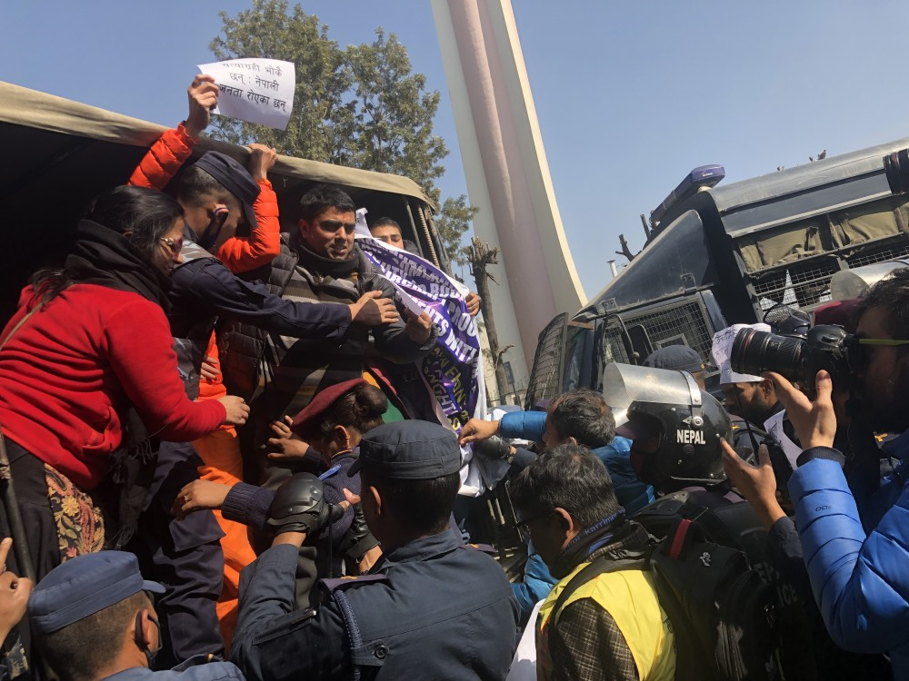
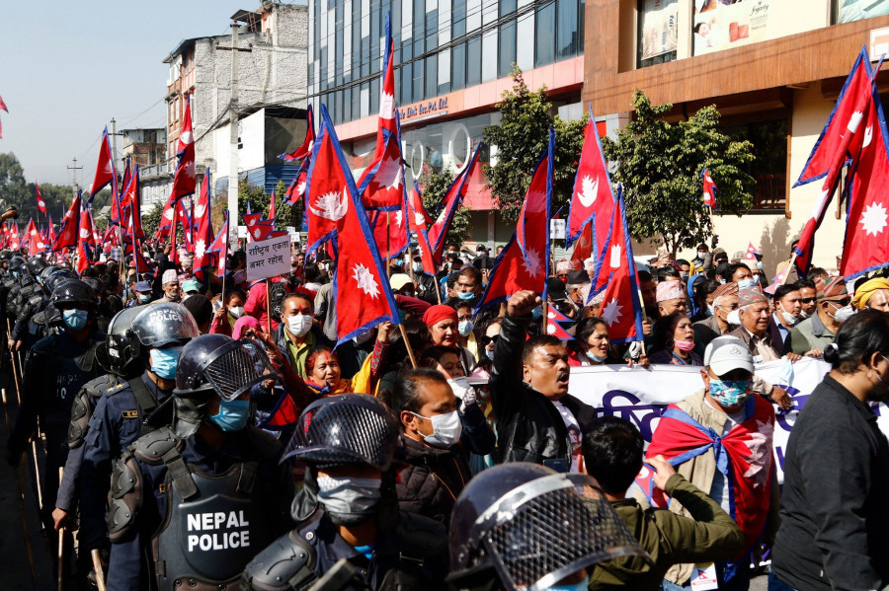
Civil and Political Rights
In the civil and political rights, Nepal's constitution guarantees fundamental freedoms crucial for a vibrant democracy. The constitution upholds the right to freedom of expression and media, ensuring citizens can voice their opinions without restraint. Additionally, the right to assembly and association is protected, allowing peaceful gatherings and the formation of unions. The constitution emphasizes inclusive political participation and representation, ensuring marginalized groups have proportional representation in state mechanisms. While these rights are enshrined in principle, challenges persist, such as occasional limitations on peaceful assembly and concerns about freedom of the press. Achieving the full realization of these rights requires not only constitutional guarantees but also effective enforcement, especially in addressing societal and institutional barriers.

Slide 7
Socio-economic Rights
Moving beyond legal guarantees, Nepal's constitution recognizes socio-economic rights as fundamental, underscoring the commitment to citizens' well-being. The right to education is enshrined with a focus on free and compulsory education up to the secondary level. Similarly, healthcare is acknowledged as a fundamental right, promising access to basic health services for all citizens. The constitution also emphasizes economic rights, addressing historical inequalities through various social welfare programs. While commendable, challenges persist, including ensuring quality education in remote areas, overcoming healthcare disparities, and optimizing the reach of social welfare initiatives. Realizing these rights involves not only legal provisions but also concerted efforts in policy implementation, resource allocation, and addressing structural barriers to uplift the socio-economic well-being of all Nepali citizens.

Slide 8
Minority Rights and Social Inclusion
Nepal's commitment to a more equitable society is evident in its constitutional recognition and protection of minority rights. Indigenous groups, Dalits, Madhesis, and other marginalized communities find explicit safeguards, emphasizing affirmative action and proportional representation. While these constitutional provisions are commendable, challenges persist in effective implementation due to social prejudices, awareness gaps, and institutional barriers. Government policies targeting education, healthcare, employment, and land rights aim to foster social inclusion, yet more must be done to ensure these policies reach the grassroots level. Discrimination, economic disparities, and vulnerability to natural disasters remain pressing issues for marginalized communities, demanding concerted efforts from all sectors to address structural inequalities and enable their active participation in Nepal's socio-economic and political spheres.

Slide 9
Gender Equality
In Nepal, strides have been made in advancing women's rights, yet challenges persist. Legal frameworks have strengthened, criminalizing various forms of gender-based violence. Quotas in political bodies have increased women's representation, yet barriers persist in accessing leadership roles. Efforts to promote women's rights encompass education, health, and economic empowerment, challenging traditional gender roles. However, there's a need for more comprehensive implementation of laws, addressing societal norms perpetuating gender inequality, and ensuring equal access to education and economic opportunities. Sustained efforts are crucial to fully realizing gender equality in Nepal.

Slide 10
Challenges and Issues
As we assess the current landscape of human rights in Nepal, challenges persist despite significant strides. Reports of human rights violations, including arbitrary arrests and limited access to justice, continue to be documented. Caste-based discrimination, gender-based violence, and restrictions on freedom of expression present ongoing concerns. The implementation of human rights laws faces obstacles, stemming from factors such as inadequate infrastructure, limited resources, and gaps in awareness. Political instability further complicates the environment, potentially leading to an increased likelihood of human rights violations. Addressing these challenges requires a multi-faceted approach, including strengthening the justice system, raising public awareness, and ensuring a stable political environment committed to human rights protections. Despite progress, the journey towards ensuring the full realization of human rights in Nepal remains a dynamic and evolving process.

Slide 11
Role of International Community
The role of the international community is pivotal in supporting Nepal's human rights initiatives. Organizations such as the United Nations, including UNDP, UNICEF, and OHCHR, actively engage in providing technical assistance, capacity building, and advocacy. Diplomatic pressure from foreign governments and international bodies plays a crucial role in urging Nepal to address human rights concerns. Collaborative efforts between the Nepali government, civil society organizations, and international entities are essential for addressing challenges. While external support is vital, lasting progress in human rights depends on the commitment of the Nepali government to implement reforms, strengthen institutions, and uphold human rights standards within the country. The international community's support reinforces the multi-stakeholder approach needed to promote and protect human rights in Nepal.

Slide 12
Case Studies and Examples
Nepal's journey in safeguarding human rights is illuminated through notable case studies. During the decade-long Maoist insurgency (1996-2006), both state security forces and Maoist rebels committed human rights violations, including arbitrary arrests, torture, disappearances, and killings. In response, the Comprehensive Peace Agreement (CPA) of 2006 established the Truth and Reconciliation Commission (TRC) and the Commission of Investigation on Enforced Disappeared Persons (CIEDP) to address these issues. However, these mechanisms faced challenges in delivering timely justice. Additionally, Nepal grapples with deeply rooted caste-based discrimination, particularly against Dalit's, leading to social exclusion and violence. Legal measures have been introduced, but their effective implementation remains a challenge. While legal reforms and increased women's representation in politics signify progress, the mixed outcomes underscore the ongoing efforts required to address historical injustices and ensure comprehensive human rights protection.

Slide 13
Recommendations and Future Prospects
Looking forward, Nepal's commitment to human rights can be fortified through strategic actions. Strengthening the justice system to ensure equitable access, particularly for marginalized groups, is pivotal. Comprehensive policy changes and awareness campaigns are imperative to combat systemic discrimination against Dalits, indigenous peoples, and women. The reform of transitional justice mechanisms, such as the Truth and Reconciliation Commission, is essential for addressing past human rights violations effectively. The legal framework should be enhanced to protect marginalized communities, ensuring their equal participation and access to resources. Empowering civil society is crucial, fostering an environment where NGOs can operate freely, advocate for policy changes, and monitor human rights violations. Transparency and accountability within government institutions must be prioritized to ensure effective implementation of laws and hold perpetrators accountable. The collaborative efforts of the government, civil society, international organizations, and the wider society are key to fostering lasting changes. As we navigate the future, these actions collectively pave the way for a more just, inclusive, and rights-respecting Nepal.

Slide 14
Conclusion
In conclusion, Nepal's journey to democracy, marked by significant historical shifts and constitutional reforms, underscores the nation's commitment to human rights. As we've traversed through the complexities of civil, political, socio-economic, and minority rights, we've witnessed both achievements and challenges. While strides have been made in legal frameworks, women's representation, and social inclusion, persistent issues like caste-based discrimination and gender-based violence remain. The future of human rights in Nepal hinges on strengthened justice systems, effective policy implementation, and a collective resolve to address ongoing challenges. As we reflect on this trajectory, it is evident that sustained efforts from the government, civil society, and international collaborations are crucial for the continued advancement and protection of human rights in Nepal. The journey continues, and the path forward requires a steadfast commitment to justice, equality, and the rights of every citizen.

